Slide 1
ABC Call Volume Trend Analysis
Shefalika Thapa

Slide 2
PROJECT DESCRIPTION
The project aim is to dive deep into the Customer Experience (CX) Analytics. The dataset includes details about the incoming calls that a business called ABC, which works in the insurance industry, has received.
A company's Customer Experience (CX) team is extremely important. They examine data and feedback from customers, draw conclusions from it, and then communicate these conclusions to the rest of the company. Among other things, this team is in charge of handling internal communications, managing customer data, managing customer journey maps, and managing customer experience programmes.
This project's main objective is analyzing inbound customer service, which entails answering incoming calls from clients both current and potential, and answer the questions as directed by the business tasks defined by the ABC Company.

Slide 3
APPROACH
Data Exploration: 1,17,988 Rows & 13 Columns
Found null values in the column Agent_Name and Agent_ID
Imputed “Abandoned” in the blank cells (34198) as these calls have been abandoned.
Wrapped_By column had 47877 null values and mode was imputed which came out to be “Agent”.
The dataset has data related to inbound calls and consists of 23 days worth of data.

Slide 4
TECH STACK USED
Microsoft Excel 2019 is used to perform the analysis.
The dataset is not huge, hence can be easily analyzed using Excel.
Excel has many built in functionalities to perform calculations, build pivot tables and visualize the data in the form of charts.
Excel file link: https://docs.google.com/spreadsheets/d/1K_iXRY-QZgsnkZ6vVDNeA61TEIZzGUXC/edit?usp=sharing&ouid=111360395057791388166&rtpof=true&sd=true

Slide 5
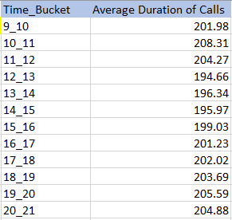
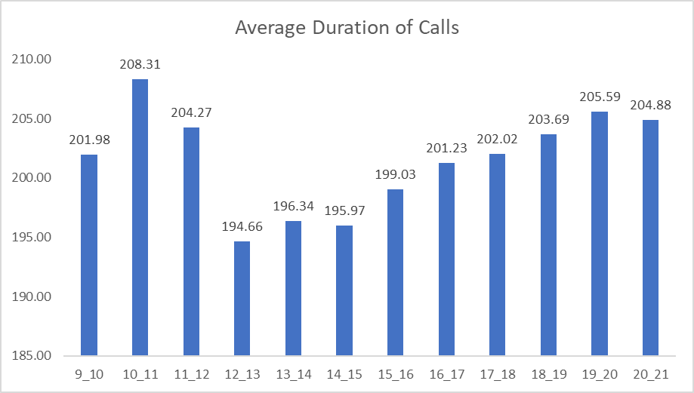
INSIGHTS : Average Call Duration
Determine the average duration of all incoming calls received by agents for each time bucket.
Overall Average Duration of Calls: 201.50s

Slide 6
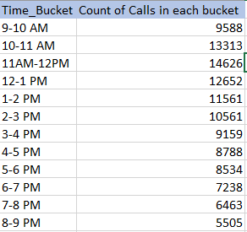
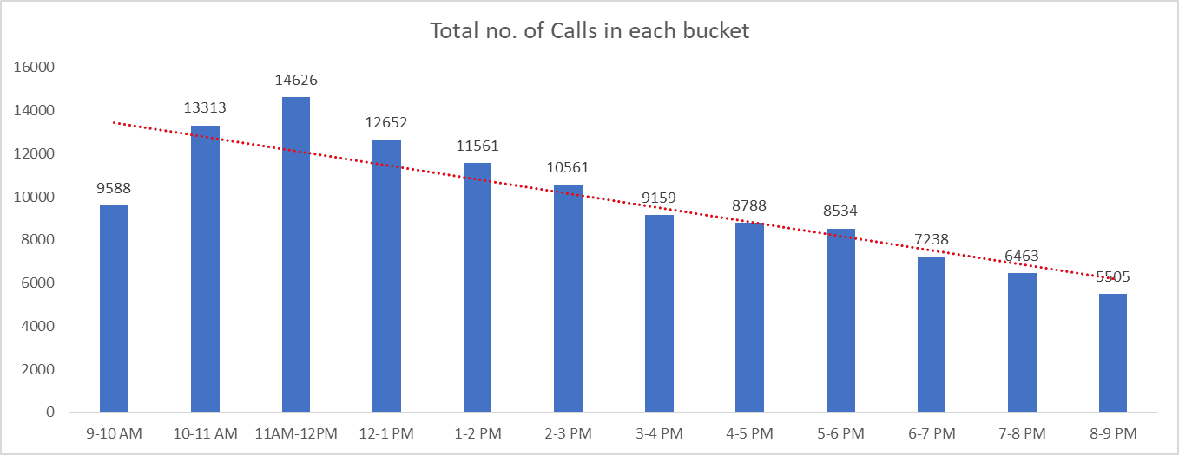
INSIGHTS : Call Volume Analysis
Visualize the total number of calls received for each time bucket.
11am-12pm time frame has the highest no. of calls.

Slide 7
INSIGHTS : Manpower Planning
The current rate of abandoned calls is approximately 30%. Propose a plan for manpower allocation during each time bucket (from 9 am to 9 pm) to reduce the abandon rate to 10%.
Assumptions: An agent works for 6 days a week. On average, each agent takes 4 unplanned leaves per month; An agent's total working hours are 9 hours, out of which 1.5 hours are spent on lunch and snacks in the office. On average, an agent spends 60% of their total actual working hours (i.e., 60% of 7.5 hours) on calls with customers/users. The total number of days in a month is 30.

Slide 8
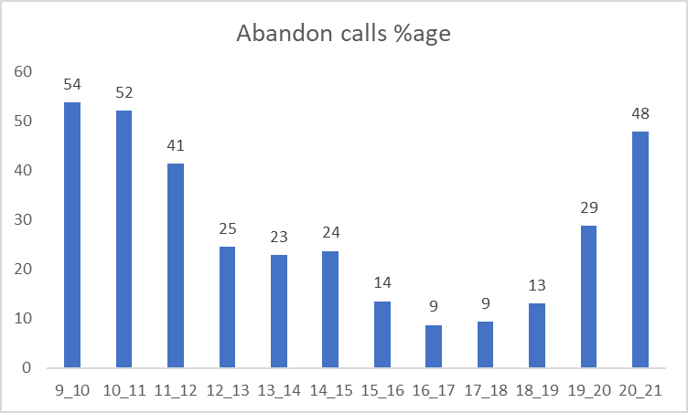
Abandoned Calls Percentage in each Time Bucket

Slide 9
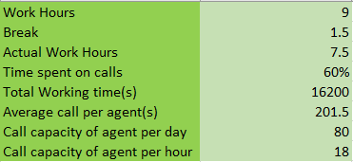
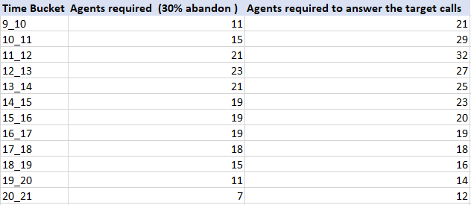
Basic Calculations Based on Given Information and Assumption

Slide 10
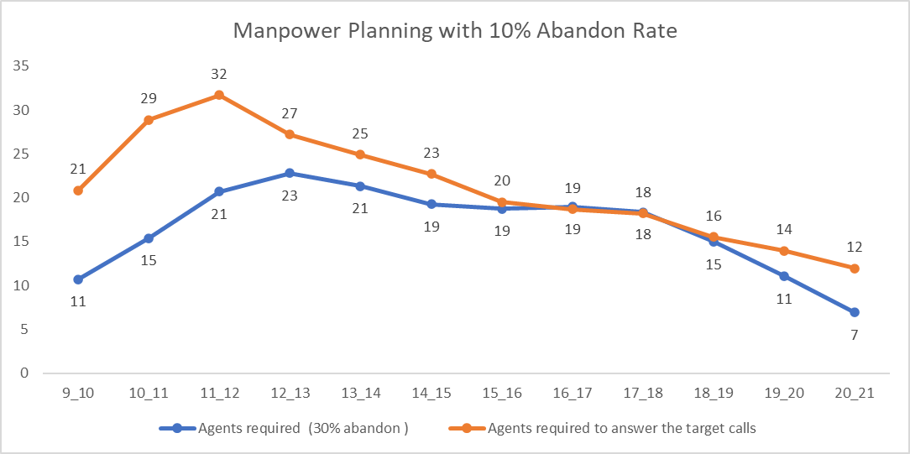

Slide 11
INSIGHTS : Night Shift Manpower Planning
Assume that for every 100 calls that customers make between 9 am and 9 pm, they also make 30 calls at night between 9 pm and 9 am. The distribution of these 30 calls is as follows:

Slide 12
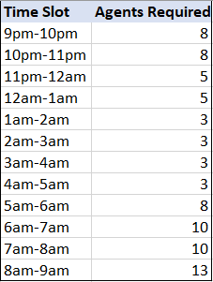
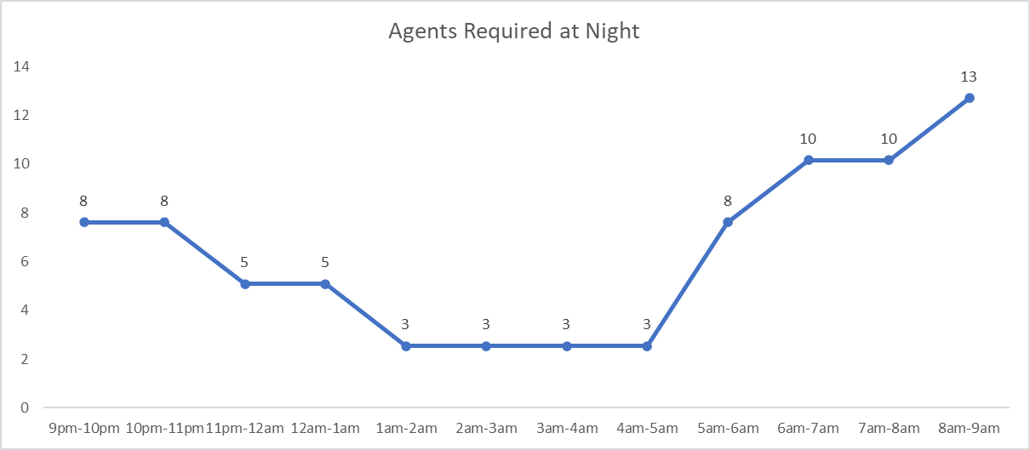

Slide 13
CONCLUSION
Highest average of call duration is 208.31s during the 10AM-11AM time frame. Overall average is 201.50s.
Highest number of calls (14,626) are received during the time frame of 11AM to 12PM. Also, the number of calls decrease as the day goes on.
Around 40-50% calls are abandoned during the morning hours (between 9AM-12PM). Hence, the company needs to address this issue as the abandon rate is quite high during the peak hours.
Consequently, while planning the manpower(day), it is observed that more agents are required for the morning slots as compared to the evening slots.
Similarly, manpower planning at night requires more agents during the early night time and during early morning time. Hence, the company needs to plan accordingly.

Slide 14
RESULT
This case study required some assumptions to be made and calculations to arrive at the result. This helped my logical thinking and problem solving skills.
Also, using Excel for pivot tables and visualizing the results to better communicate to the stakeholders enhanced the Excel skills such as pivot tables, formulas, functions, charts and graphs.

Slide 15
THANK YOU!

